Slide 1
Explore Mode 2 Storyboard Version 1.0
The Bard from Racha Den DEMO
29 November 2023

Slide 2
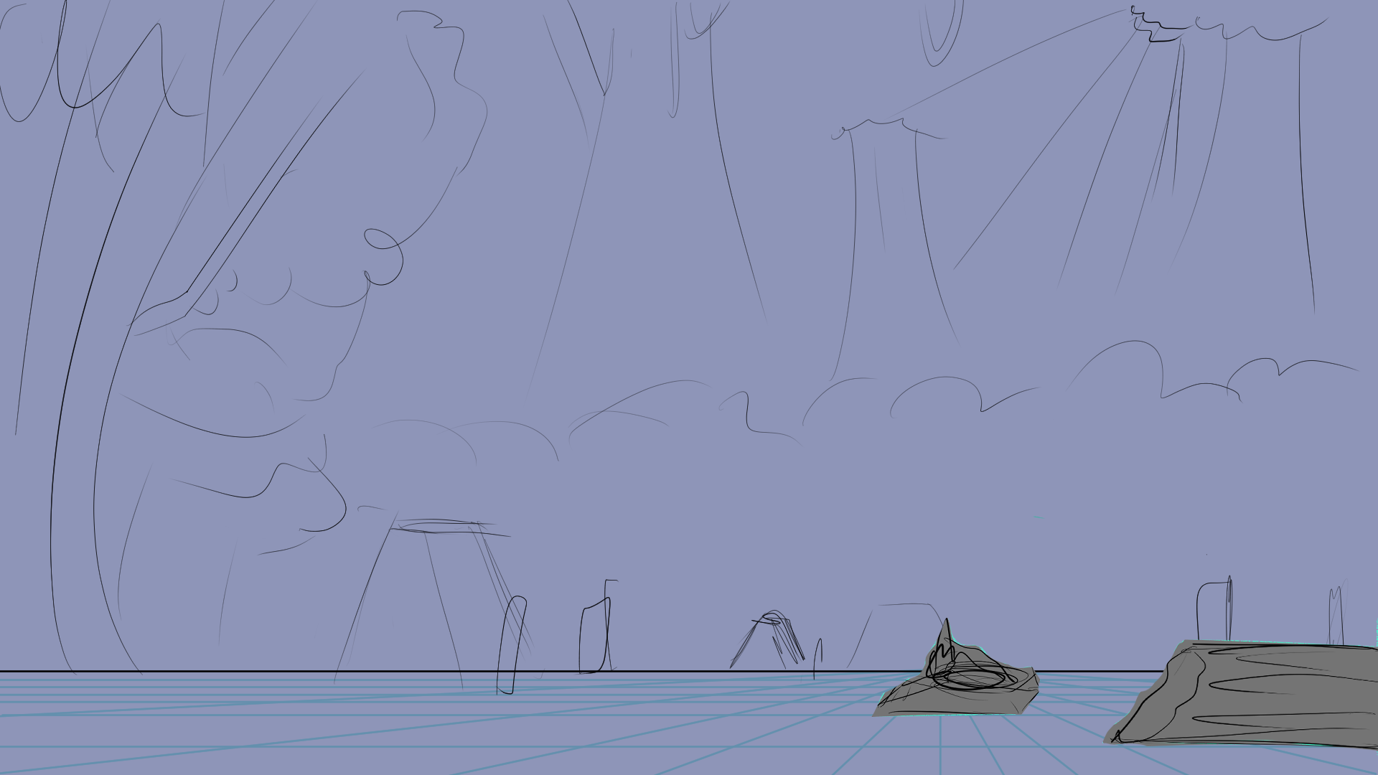

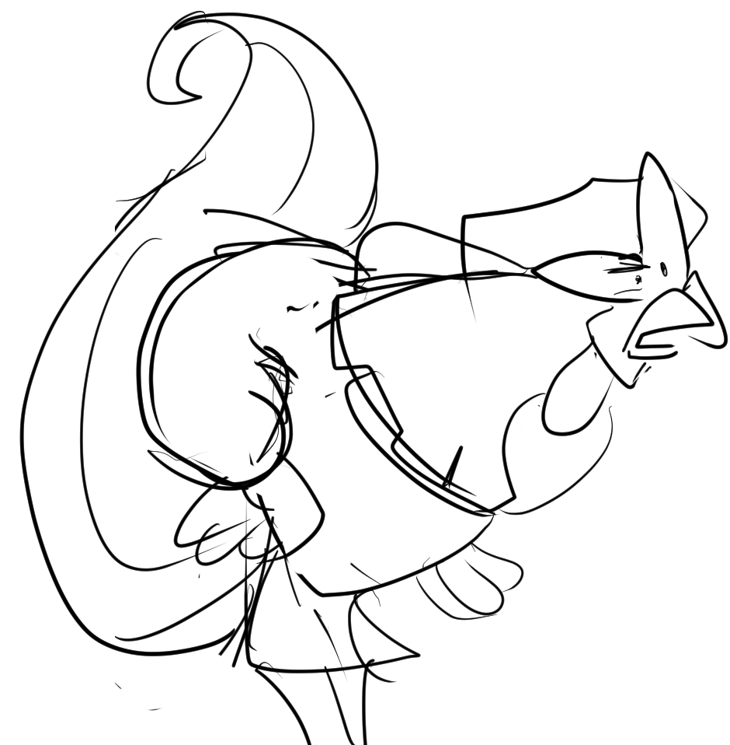
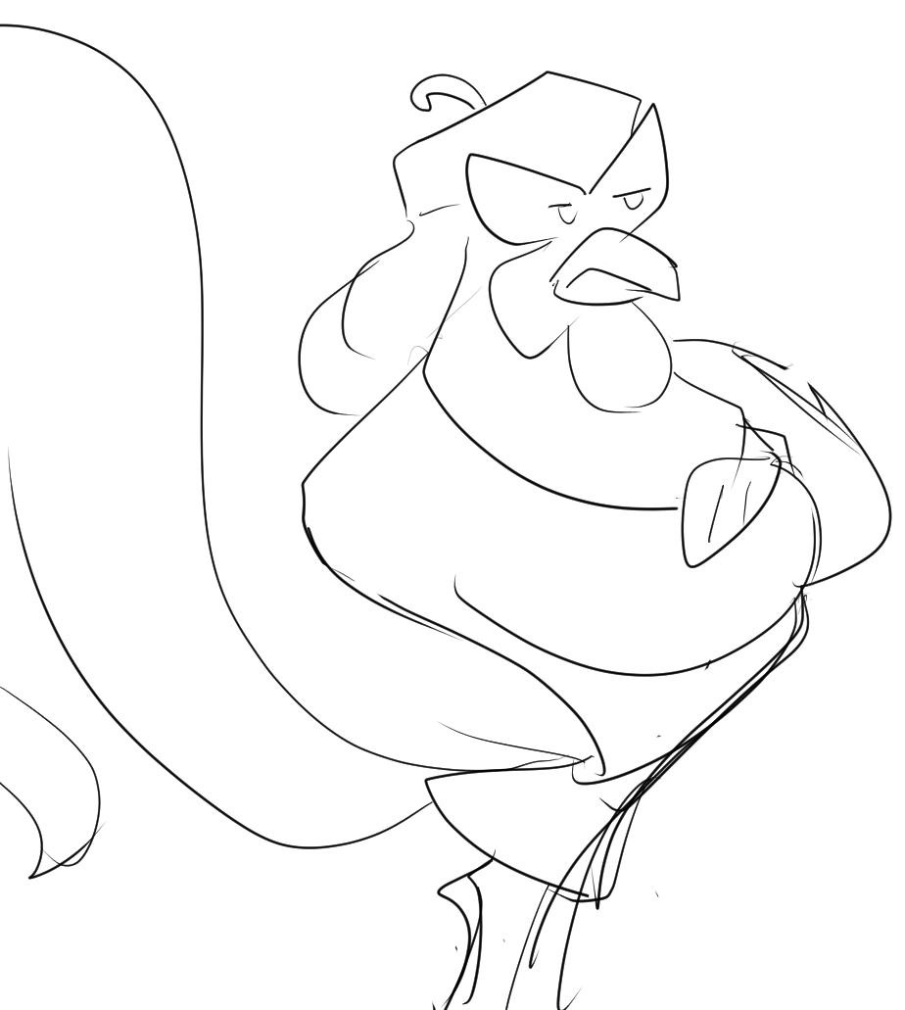
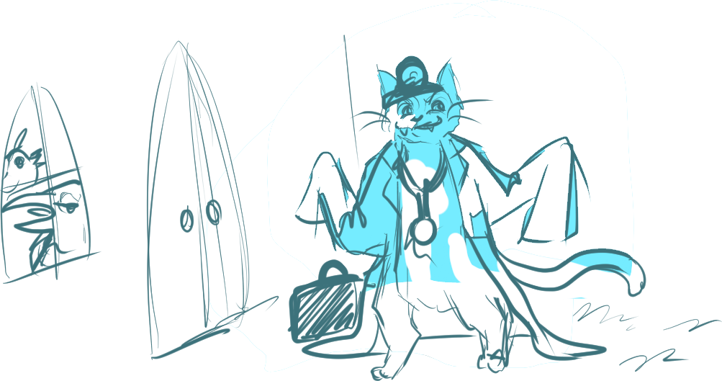
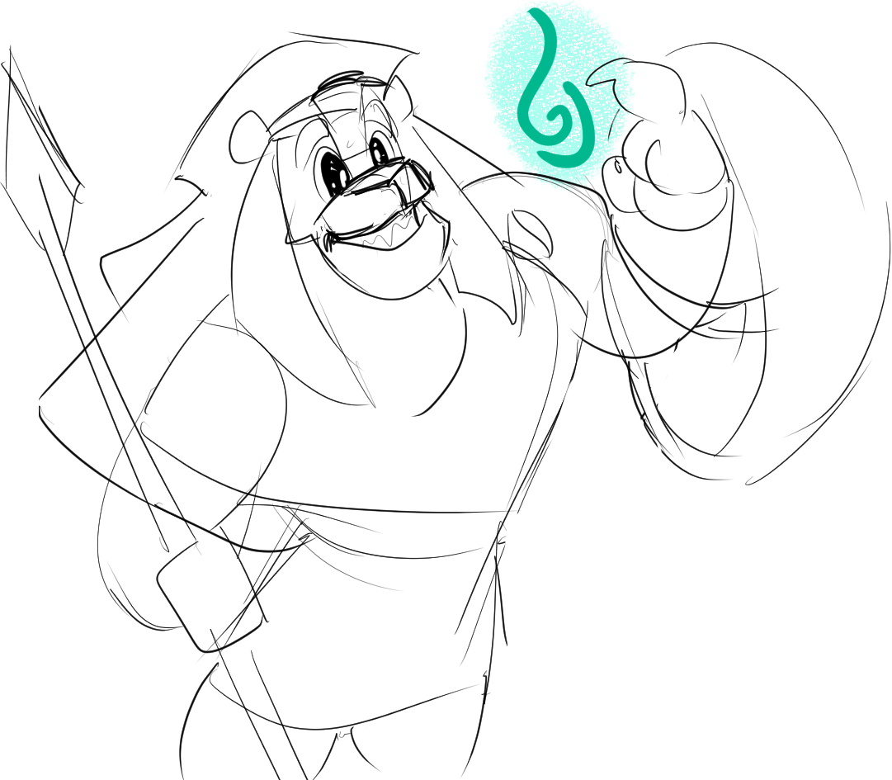
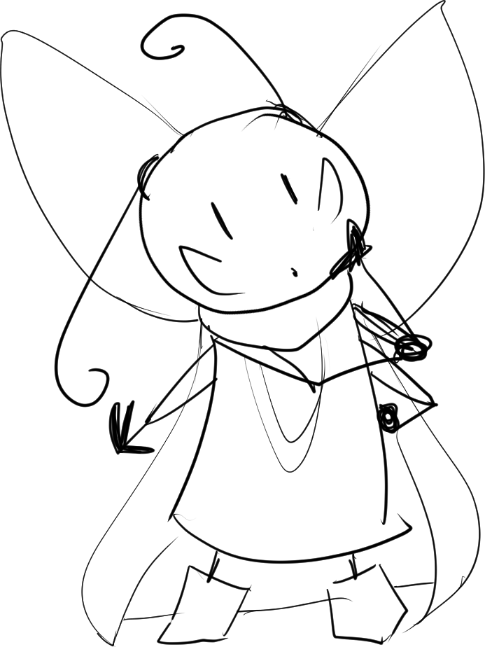
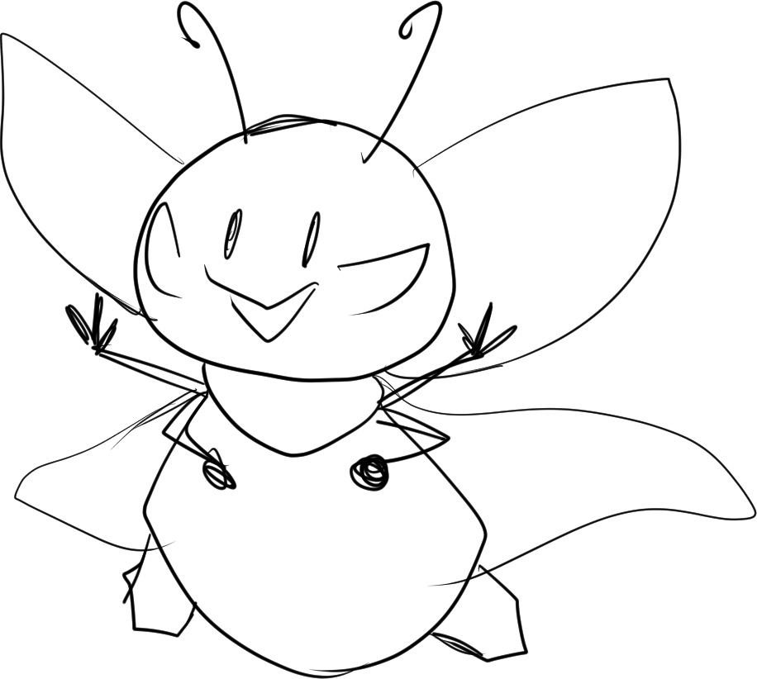


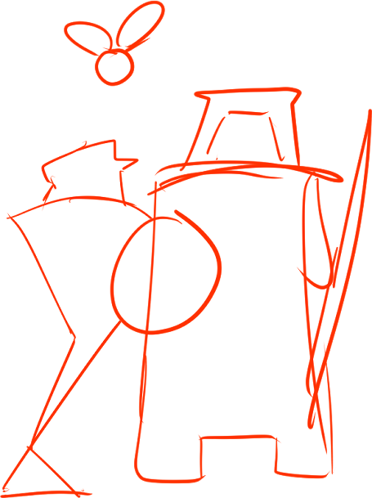

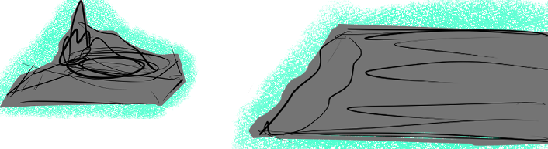
Deanna
Wisp
Deanna
Athos
Athos
Lethabo
“This sounds like a great story, but it’s not the hero’s story.”
“A cat heard that the birds in an aviary were ailing...”
“These are Aesop wisps! They’re magical Truths spoken by our ancestors from ages past.”
“You two must be pulling a prank on me. I don’t hear a thing!”
“What is that? A firefly?”
“[Incredible!] I can hear a proverb from this wisp.”
Notes:
START: [bg exp2_page 1] WITH [exp2_character placement] + [exp2_page 1_fallen pillar] + [exp2_page 1_sneezey wisp].
[exp2_page 1_sneezey wisp] TRIGGERS Athos, Deanna, and Lethabo convo + ANIMATION Athos sneezing away wisp.
[exp2_page 1_fallen pillar] TRIGGERS [exp2_page 1_story wisp] TO APPEAR.
- [exp2_page 1_story wisp] TRIGGERS [exp2_page 1_story 1].

Slide 3
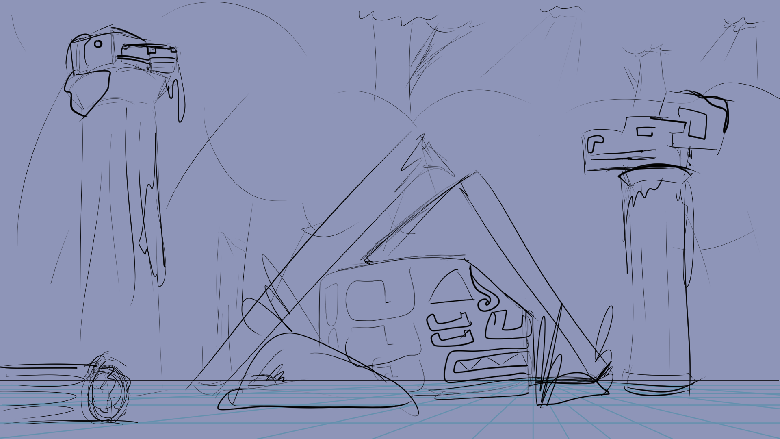
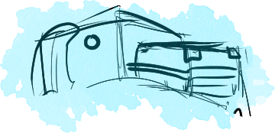
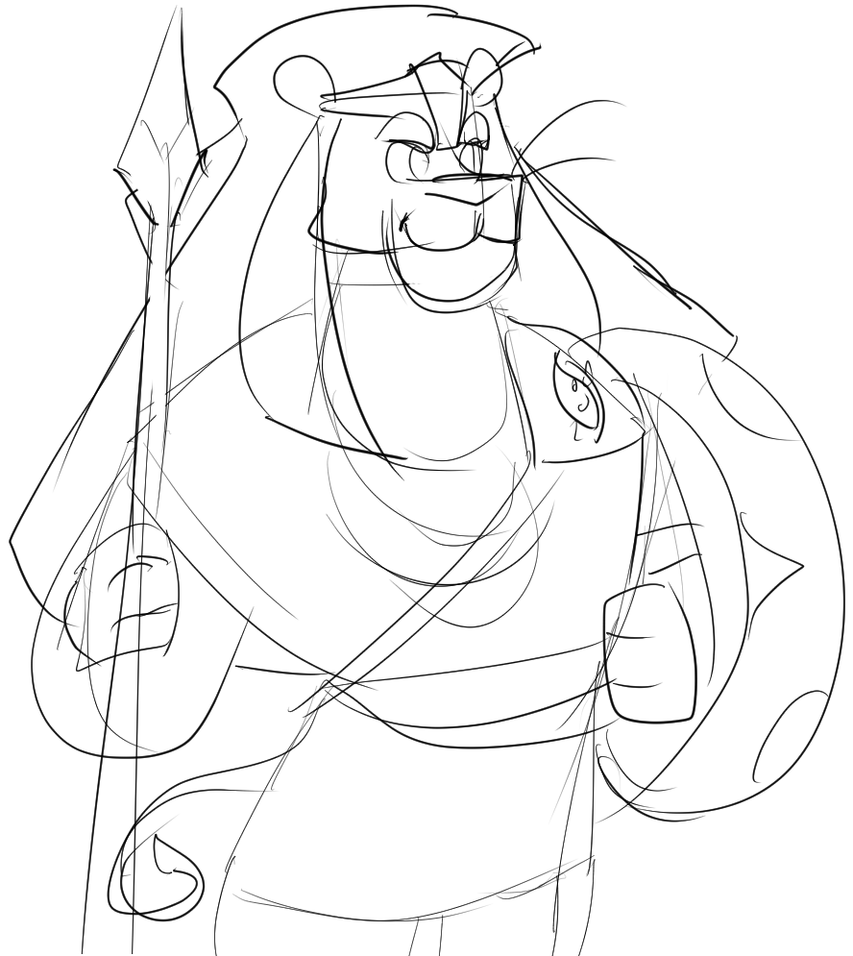
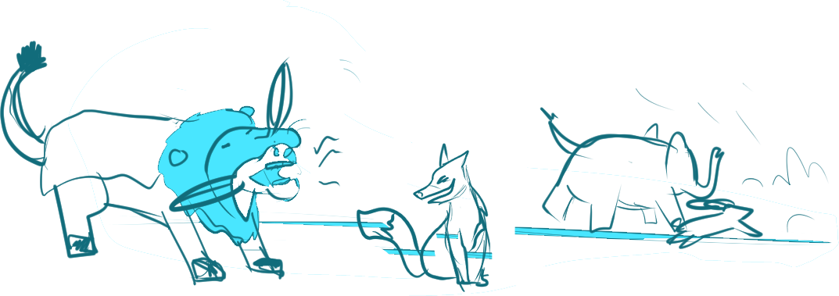
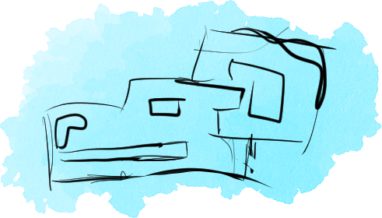

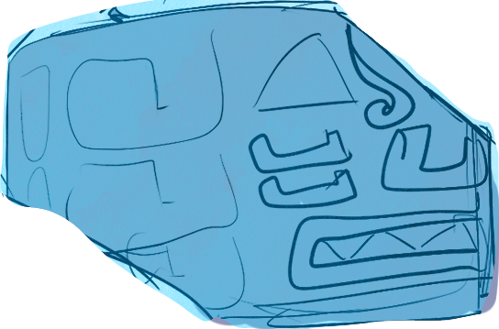
Deanna
Deanna
Wisp
Deanna
Athos
Lethabo
“I’m looking for a powerful hero’s story. One full of truth, wisdom, valor and glory. It should have enough power in it to inspire world peace!”
“If the Truth is strong enough, sí! Hopefully there’s one here.”
”An ass found a lion’s skin, and dressed himself up in it...”
“This sounds like a great story, but it’s not the hero’s story.”
“Why are we here again?”
“Aesop magic can truly do such things?”
Notes:
START: [bg exp2_page 2] WITH [exp2_character placement] + [exp2_page 2_lion head] + [exp2_page 2_goat head] + [exp2_page 2_snake head].
- [exp2_page 2_goat head] TRIGGERS SPIDER ANIMATION.
- [exp2_page 2_snake head] TRIGGERS CONVERSATION.
[exp2_page 2_lion head] TRIGGERS [exp2_story wisp].
[exp2_story wisp] TRIGGERS STORY 2.

Slide 4
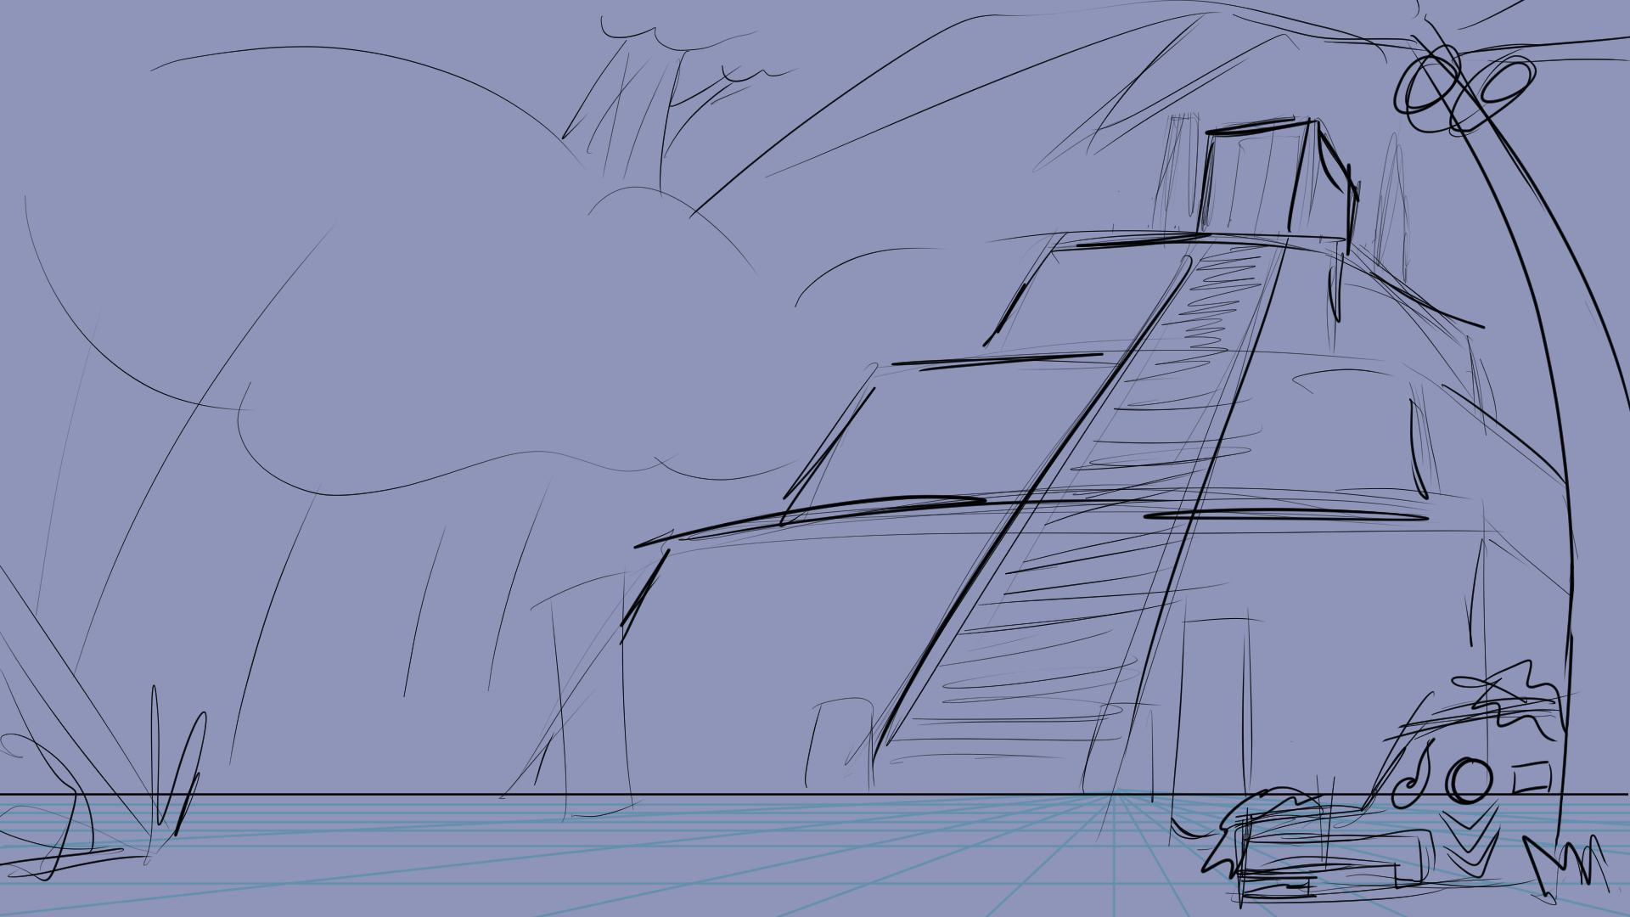
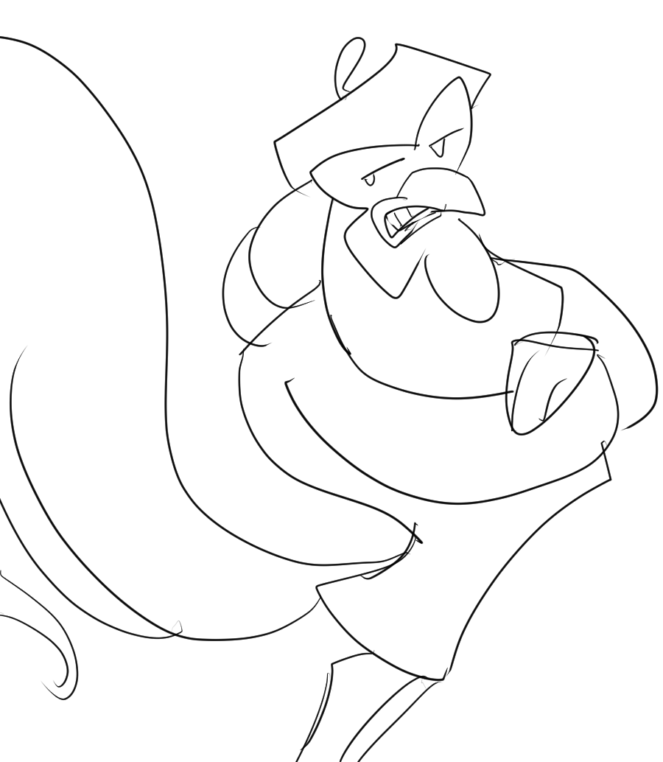
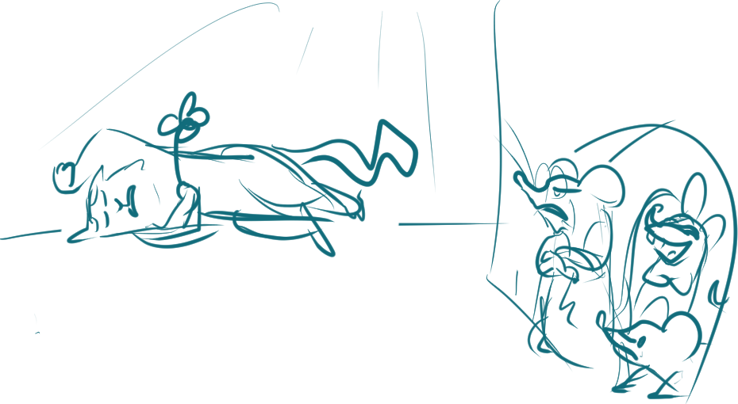

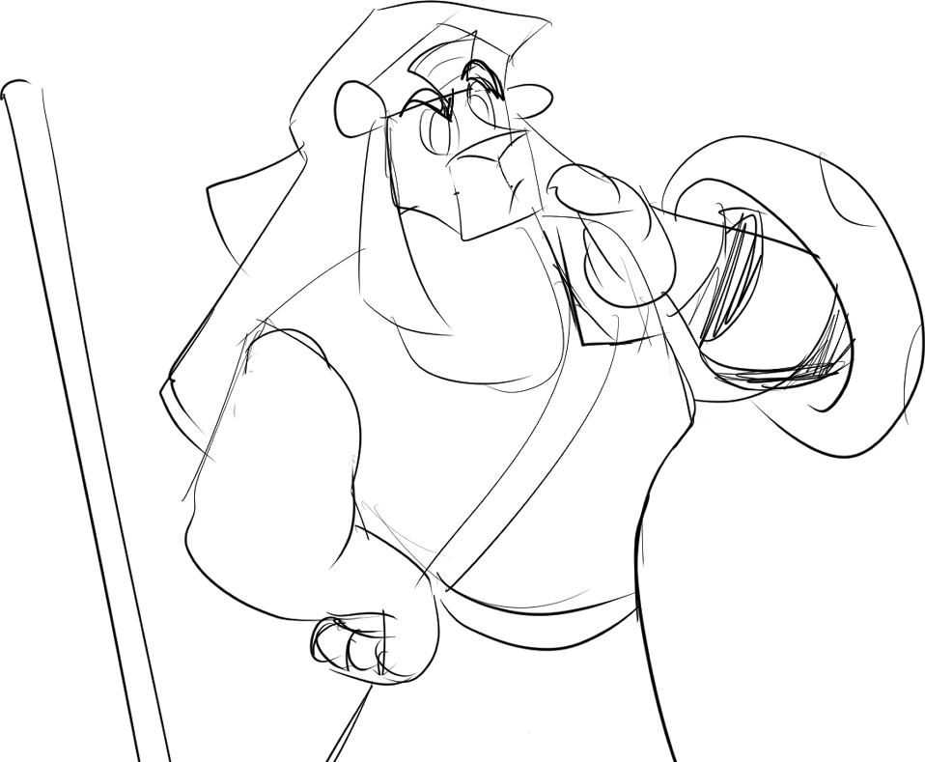
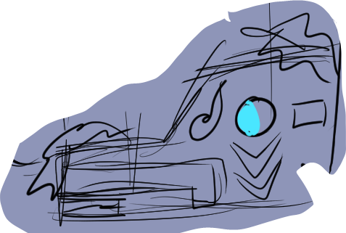
Wisp
Deanna
Deanna
Athos
Lethabo
“There once was a house that was overrun by mice...”
“How come no one else found this place?”
“This sounds like a great story, but it’s not the hero’s story.”
“Perhaps monster-infested jungles isn’t prime for potential tourism.”
“These are old ruins. I want to say many thousands of years old.”
Notes:
START [bg exp2_page 3] WITH CHARACTER PLACEMENT + [exp2_page 3_head ruin 1] + [exp2_page 3_coconut 1]. - IMMEDIATELY PLAY CONVERSATION.
[exp2_page 3_head ruin 1] TRIGGERS [exp2_page 3_wisp refuse] ANIMATION. WILL REPEAT IF PUZZLE NOT SOLVED.
[exp2_page 3_coconut 1] TRIGGERS [coconut 2] TWO TIMES.
SECOND CLICK TRIGGERS COCNUT FALLING ANIMATION.
ANIMATION TRIGGERS [exp2_prop_story wisp] TO SHOW AND MAKES IT CLICKABLE.
[exp2_prop_story wisp] TRIGGERS [exp2_page 3_story 3].

Slide 5
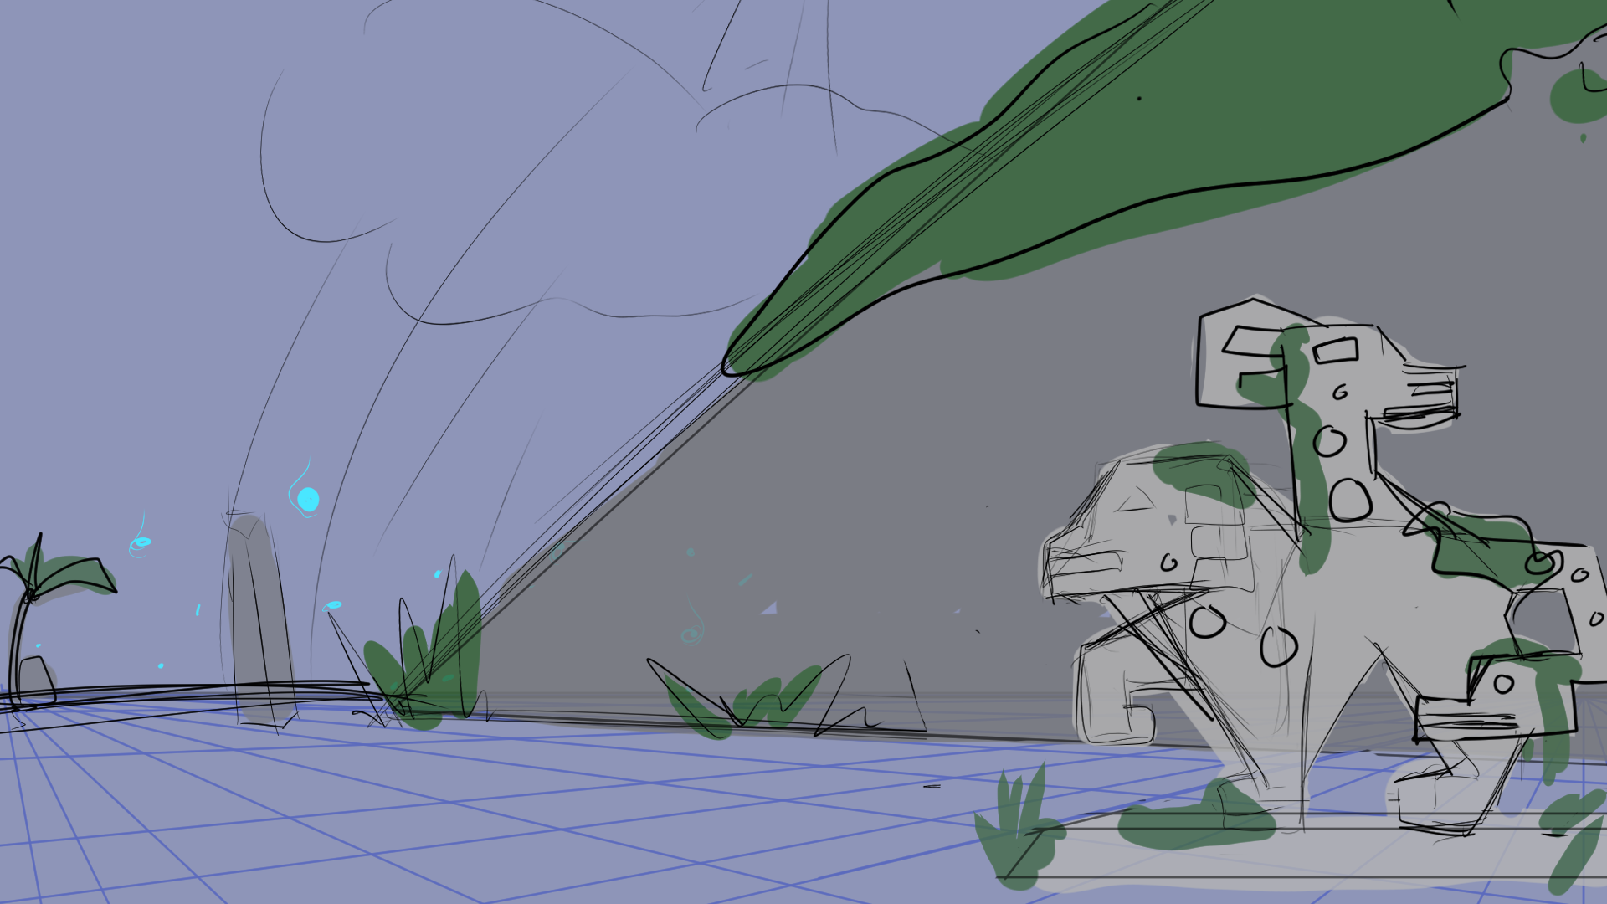
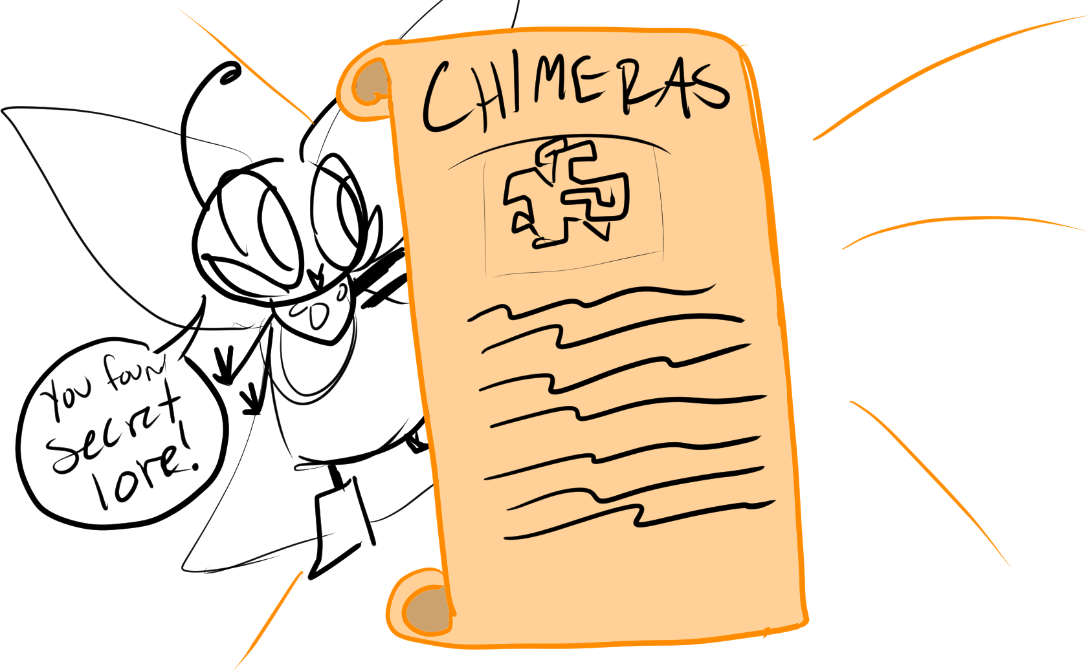
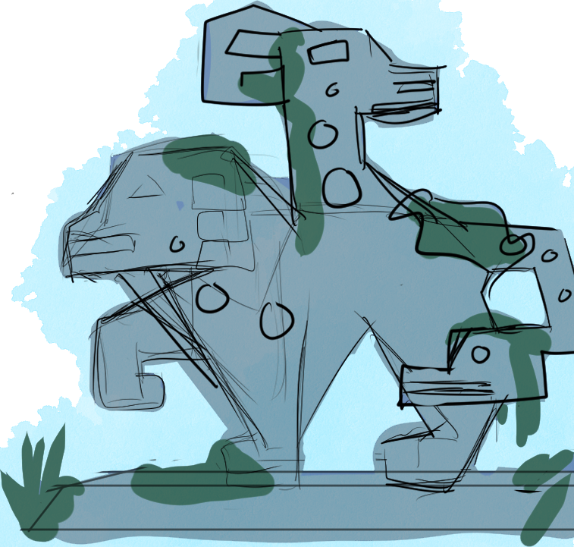
Notes:
START [bg exp2_page 4] WITH CHARACTER PLACEMENT + [exp2_page 4_chimera 1].
[exp2_page 4_chimera 1] TRIGGERS [exp2_page 4_secret lore].

Slide 6
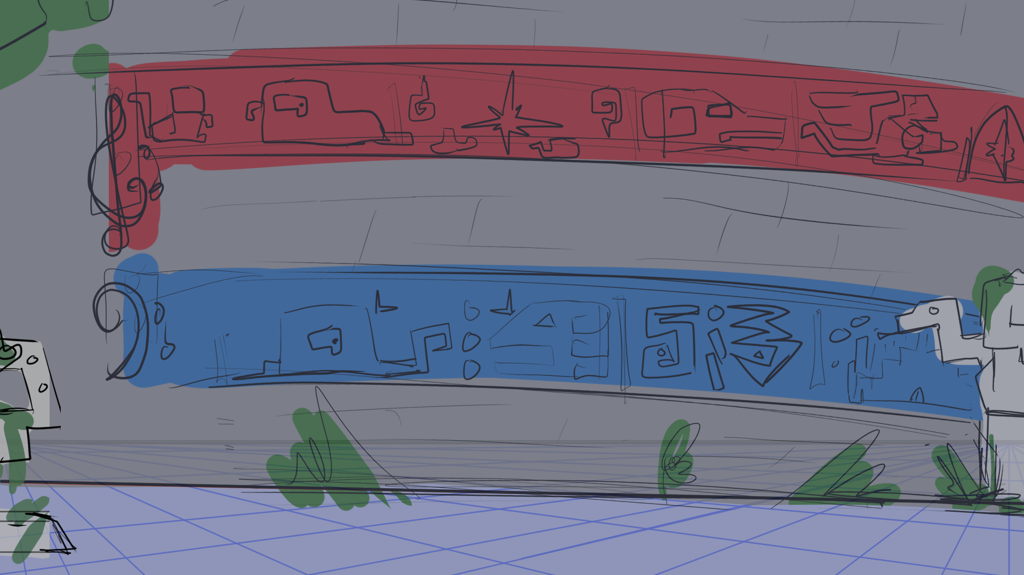
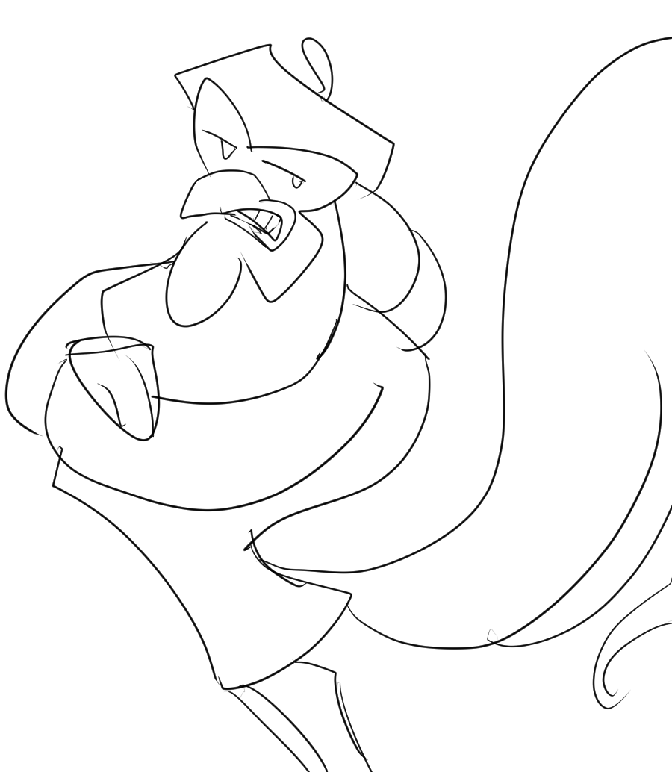
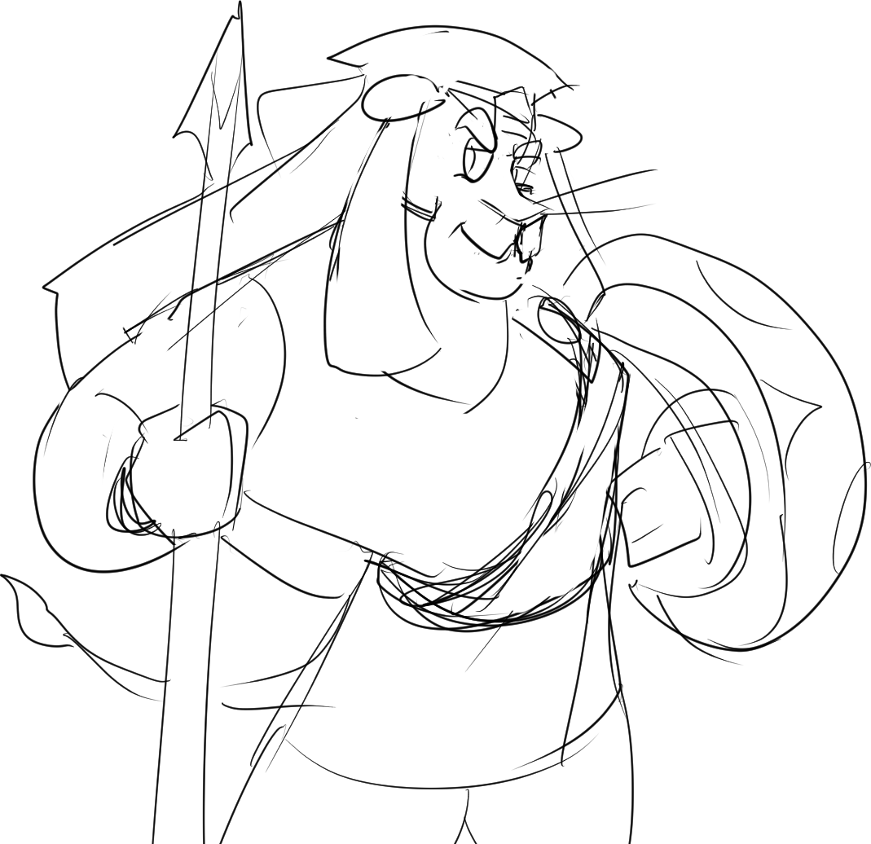
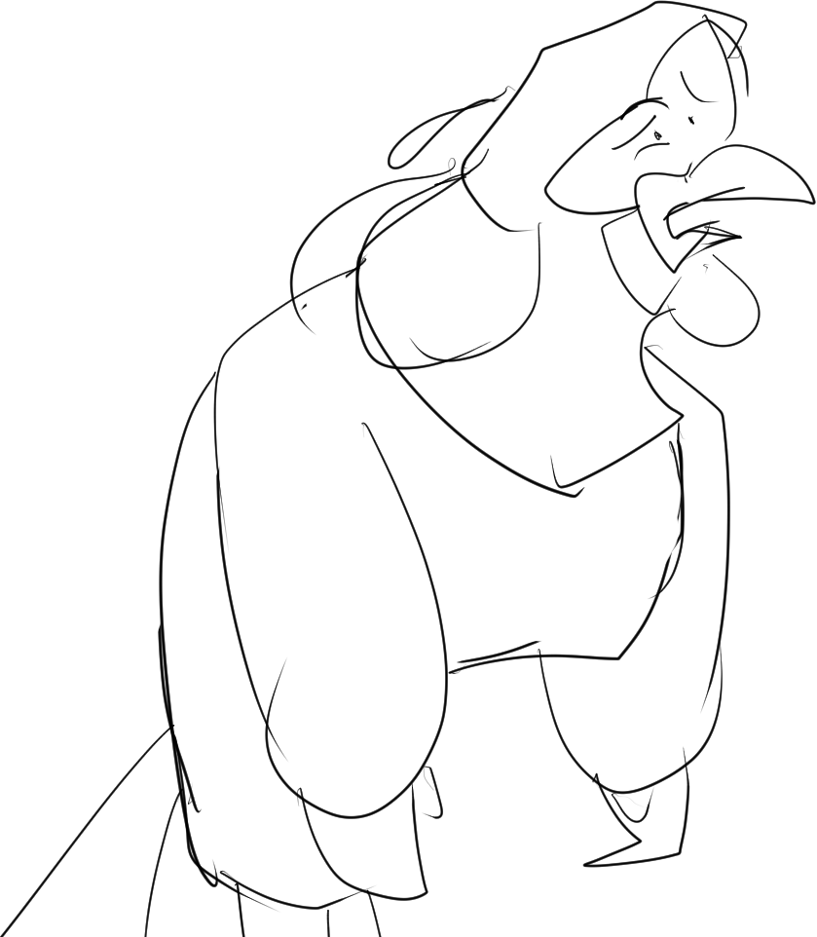

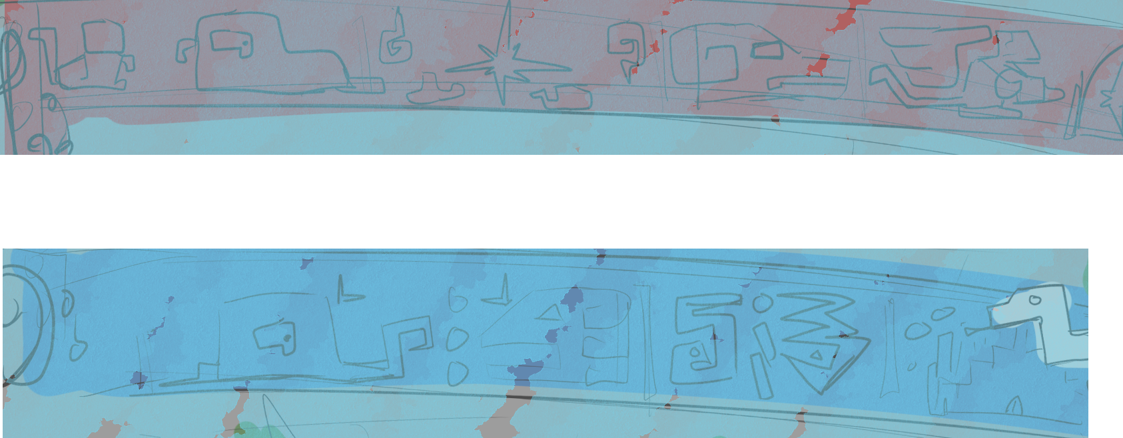
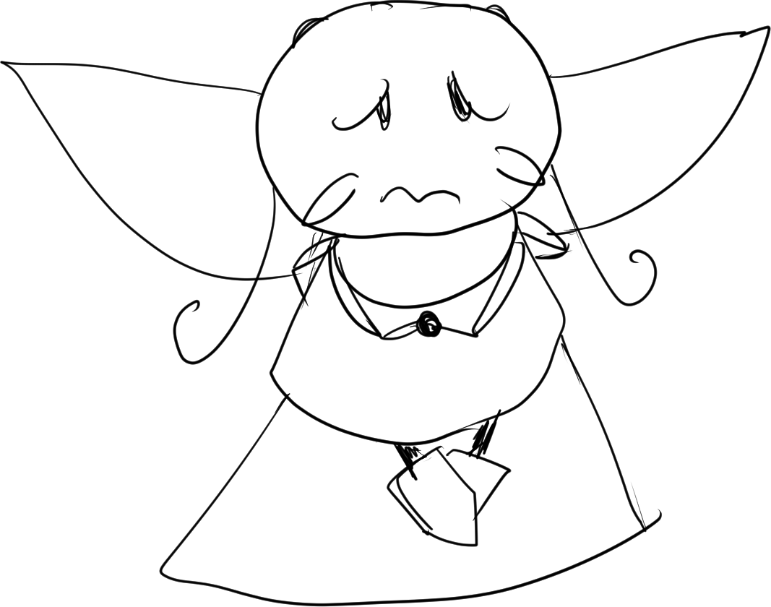
Deanna
Deanna
Athos
Athos
Lethabo
“Well, they left us Aesop magic, so they must be good… (Right?)”
“I recognize these designs. I think these ruins were from the Ancients themselves!”
“Mainly that I’d prefer not to let my fate lie in those who left our world to rot to begin with.”
“[Oh geez], now you’re telling me those gods existed, too?”
“Why? You have something heavy on your conscience, Athos?”
Notes:
START [bg exp2_page 5] WITH CHARACTER PLACEMENT + [animation_heiroglyphs 1].
[animation_heiroglyphs 1] TRIGGERS CONVERSATION.

Slide 7
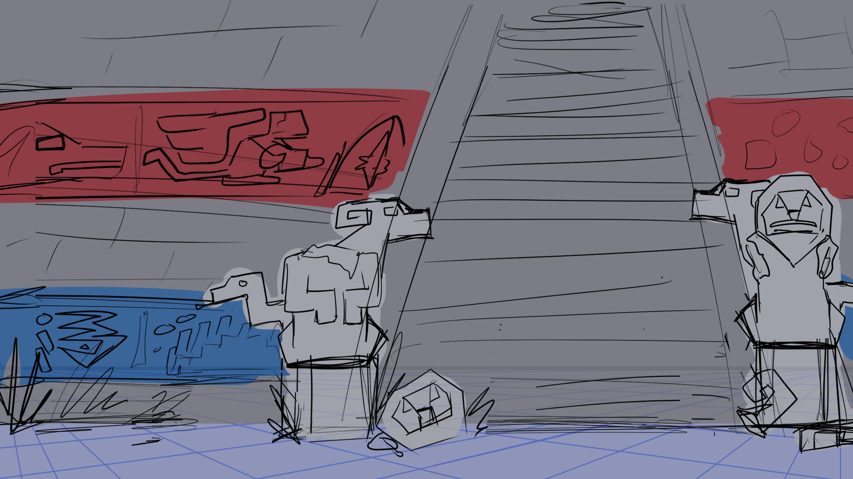
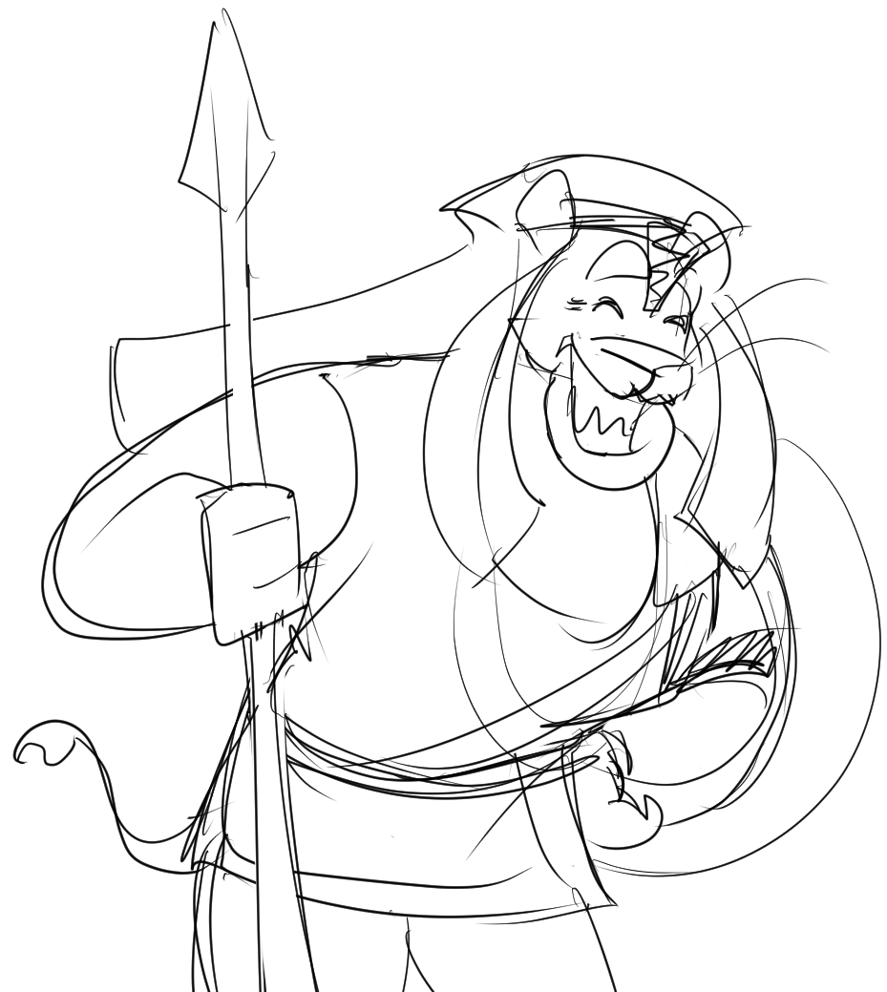
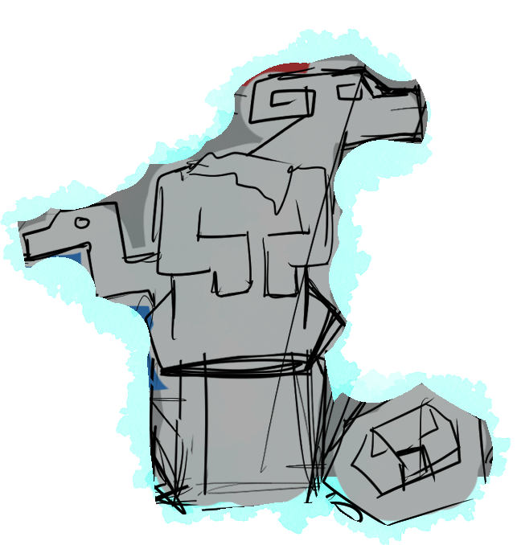
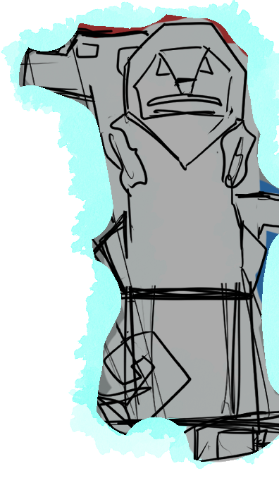
Lethabo
“A pity. This fellow really lost his head. Too bad no one was there to lend a hand.”
Notes:
START [bg exp2_page 6] WITH [exp2_page 6_armless statue 1] + [exp2_page 6_headless statue 1].
EITHER STATUES TRIGGER CONVERSATION.

Slide 8
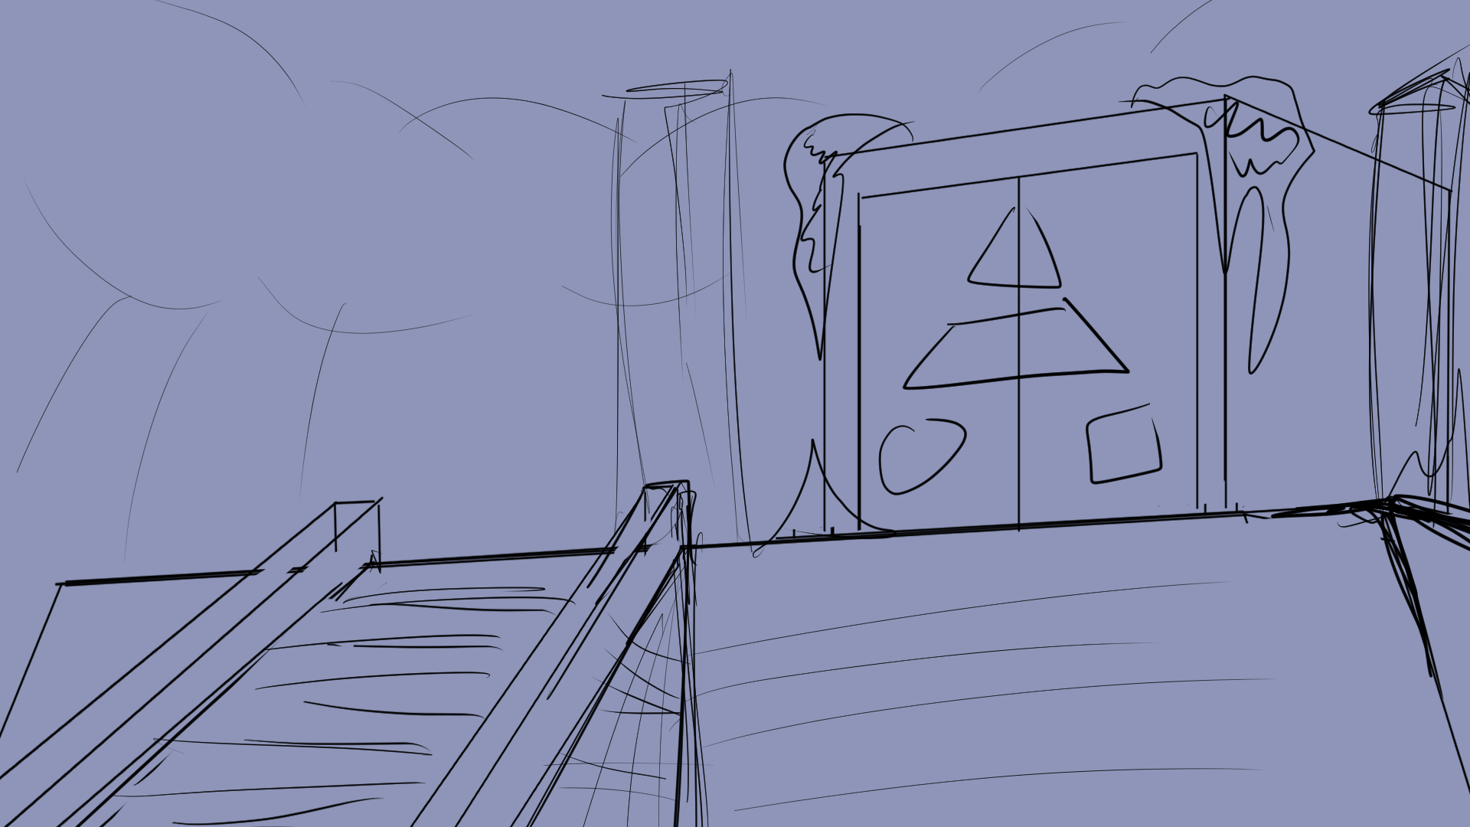
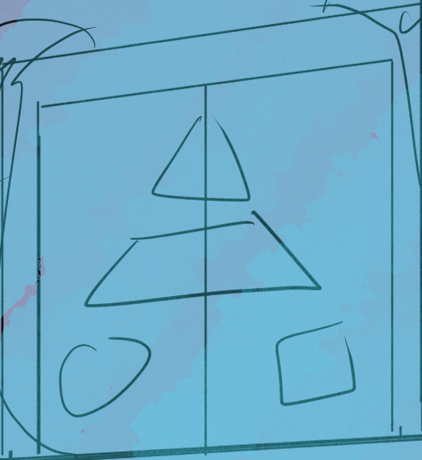
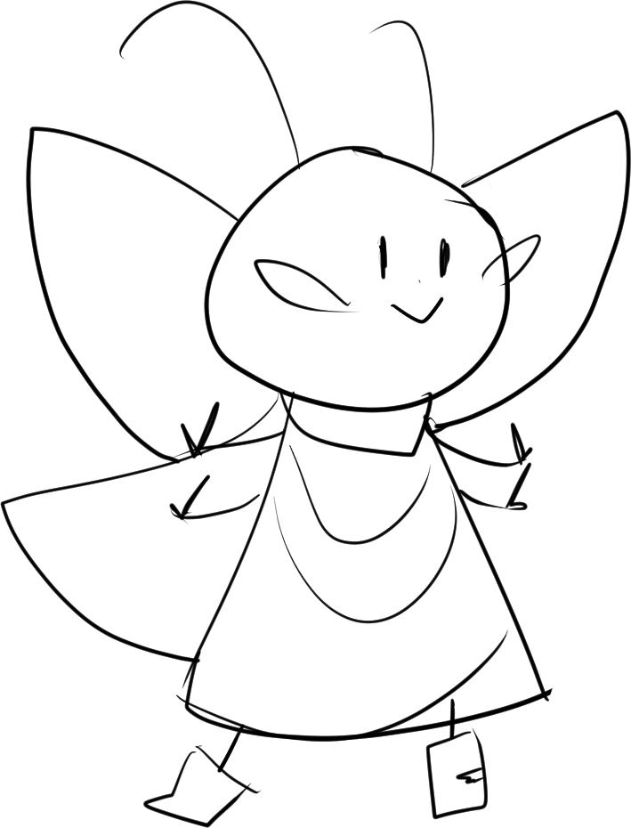
Deanna
Lethabo
“No, but I do sense a wisp inside. Let’s go in!”
“Are these the Ancient Doors?”
Notes:
START [bg exp2_page 7] WITH CHARACTER PLACEMENT.
IMMEDIATELY PLAY CONVERSATION.
[exp2_page 7_ruin doors 1] TRIGGERS PUZZLE.

Slide 9
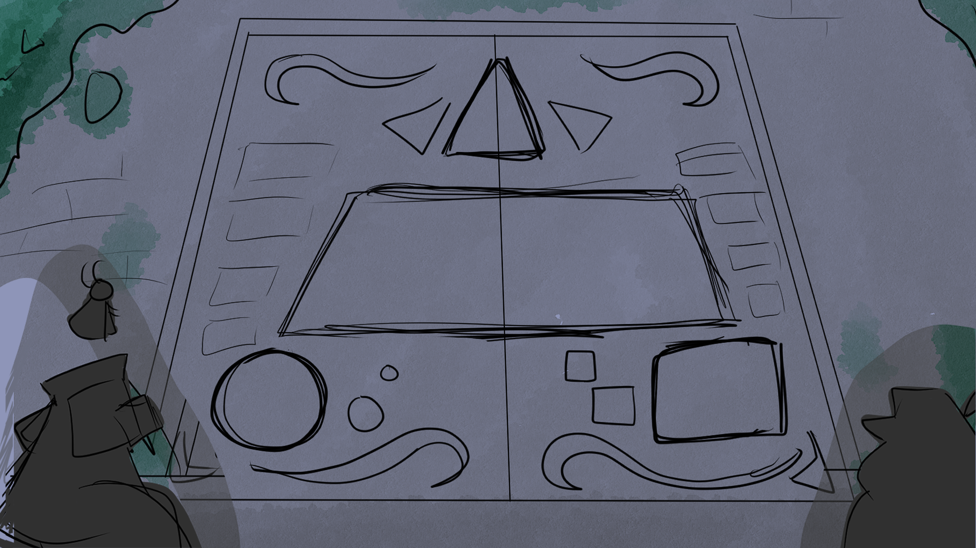








Notes:
START [bg exp2)page 8] WITH [hint buttons], [shape outlines] AND [wisps].
PROPS:
HINT buttons (for Lethabo and Athos) on BOTTOM
WISPS on STAGE RIGHT.
>WISP STORY at CENTER when ACTIVATED.
SHAPE OUTLINES on designated areas on DOOR.
LOGICAL FALLACY within CENTER TRAPEZOID when ACTIVATED.
The puzzle is solved when all three wisps are correctly matched with the presented shapes (or fallacies).
Solved puzzle continues onto PAGE 9.

Slide 10
Notes:
AUTOMATIC CUTSCENE – NO INTERACTION

Slide 11


Notes:
START: bg exp2_page 6

Slide 12
Notes:
START: bg exp2_page 5

Slide 13

Notes:
START: bg exp2_page 4

Slide 14
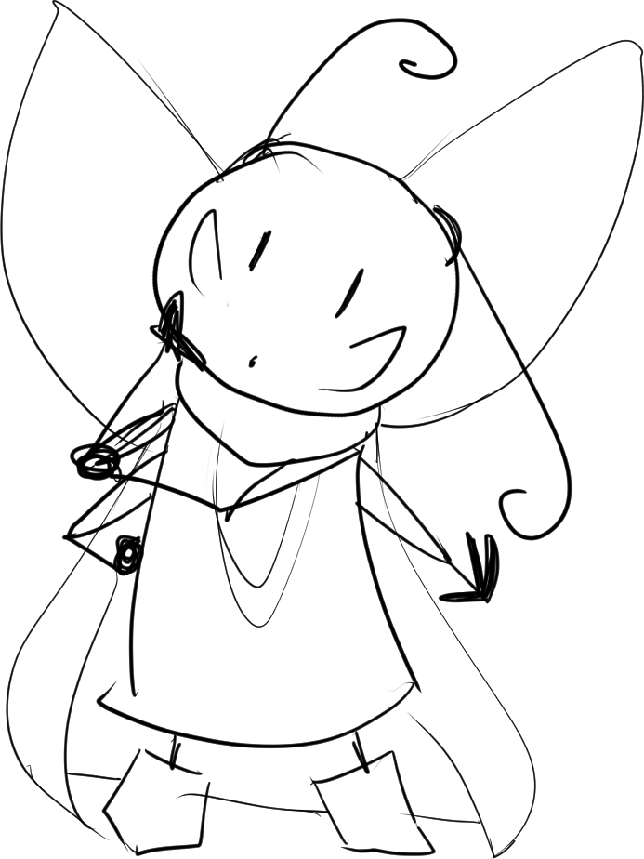
Deanna
“Where the other wisps go?”
Notes:
START: bg exp2_page 3

Slide 15
Notes:
START: bg exp2_page 2

Slide 16
Notes:
TO BE FINISHED SOON.

Slide 17
END OF Explore Mode 2
TRANSITION TO Storybook 3

Slide 18
Lethabo
“Dialogue.”
Deanna
“Dialogue.”
Athos
“Dialogue.”
Narration.

